Slide 1
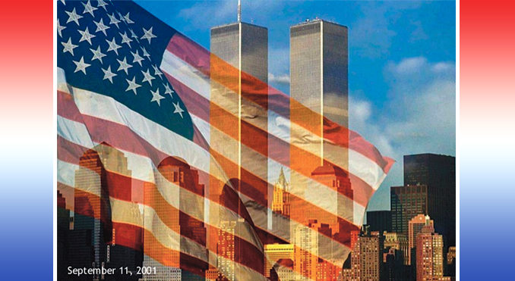
Remembering 9/11
The Transformation of Global Security after 9/11

Slide 2
Transformation of Global Security Post 9/11
2002 U.S. National Security Strategy –
“disrupt and destroy terrorist organizations of global reach.”
Tech Advances to Prevent Future Attacks
Drones
Data collection and analytics
Remote-controlled airliners
Bio-monitors
Remote Video Monitoring
Notes:
https://www.cfr.org/councilofcouncils/global-memos/911-effect-and-transformation-global-security
The 9/11 attacks fundamentally reshaped the U.S. intelligence community and those of many of its close allies. In the words of a former CIA station chief, the CIA underwent a massive transformation—from gathering to hunting. This new mission supported an emphasis on kinetic counterterrorism, enshrined in the 2002 U.S. National Security Strategy, with its determination to “disrupt and destroy terrorist organizations of global reach.”
The New World of Surveillance
The 9/11 attacks fundamentally reshaped the U.S. intelligence community and those of many of its close allies. In the words of a former CIA station chief, the CIA underwent a massive transformation—from gathering to hunting. This new mission supported an emphasis on kinetic counterterrorism, enshrined in the 2002 U.S. National Security Strategy, with its determination to “disrupt and destroy terrorist organizations of global reach.”
The global war on terror required a shift in surveillance targets from traditional state threats and their militaries to much more amorphous terrorist networks. The nonstate actor threat required new tools and methods for surveillance. Led by the United States, the post-9/11 world of surveillance features an increasing reliance on a new tool of imagery intelligence—the drone—which rapidly became a dual-use weapon for both gathering and, in its armed form, hunting.
Drone use escalated during the Afghanistan conflict, as did attendant controversies about rules of engagement and civilian casualties. It spilled across borders, particularly into Pakistan, which harbored terrorist groups fighting in Afghanistan, and ultimately into other theaters, such as Iraq, Somalia, and Syria. Although the United States led in drone innovation, it quickly entered the intelligence and military arsenals of many other states. As commercial and technical accessibility grew and costs fell, it even into the hands of terrorist groups such as the self-proclaimed Islamic State.
A second critical development was the rise of domestic and global internet monitoring, and with it the advent of mass data collection and analytics. Ingestion of vast quantities of what is technically described as unselected information required new data storage, management, and analysis tools, including unprecedented computing power and the application of artificial intelligence to filter information. This new form of surveillance, representing as it did a historic turn away from targeted intelligence gathering, also needed a rationale, often depicted as finding needles in haystacks, but with a twist. Intelligence communities now argued that exploring the haystack was required to properly focus intelligence on its needle-like targets.
Mass data surveillance raised new global political tensions, which came to the fore with the revelations of the former National Security Agency contractor Edward Snowden, who revealed elements of the scale of the U.S. program, which operated in conjunction with the Five Eyes intelligence partners (Australia, Canada, New Zealand, and United Kingdom). The Snowden revelations also led to profound and enduring controversies over the legality of mass data surveillance and concerns over privacy protections and rights in democratic countries.
When state intelligence systems led, driven by a preoccupation with counterterrorism, the private sector followed. The corporate world may eventually use drones to bring parcels to our doorsteps, but what it really grasped was the potential for mass data surveillance and analytics to find, target, exploit, and keep consumer audiences, aided by the rise of social media platforms for expansive advertisement.
The growth of surveillance for intelligence and war fighting is a prime legacy of the 9/11 attacks. It has now found a wholly unexpected parallel existence in surveillance for commerce—the aptly named surveillance capitalism.
Meanwhile, threats lost sight of in the years of preoccupation with terrorism have reemerged, conjuring new forms of state surveillance. The experience of COVID-19 has introduced the world to the need for systemic health surveillance within and beyond national borders.
If there is an upside, it is that changes in the world of state and private-sector surveillance have also revitalized debates about global governance, democratic rights, accountability, and privacy.
https://www.nationalgeographic.com/history/article/110907-9-11-september-11-anniversary-science-tech-prevent
9/11: Six Tech Advances to Prevent Future Attacks
RC airliners, "dazzlers" among proposed tech to tackle air-based terrorism.
s the tenth anniversary of 9/11 approaches, imagine a replay of the attack: Another band of terrorists armed with box cutters manages to sneak onto an airliner and attempts to seize it for a suicide mission. (Read "The Original Plans for 9/11.")
As the terrorists rush into the cockpit, sensors send out an alarm to antiterrorism officials on the ground. They remotely disable the cockpit controls, engage an uninterruptible autopilot system, and land the plane in a secure location, where Navy SEALs rush on board and capture or kill the terrorists.
It's not as far-fetched as you might think.
(See a time line of the events of 9/11.)
Airliner remote control is just one of the many technologies on the horizon that could potentially thwart aviation-based attacks like the 9/11 disaster, according to government documents, journal articles, and antiterrorism experts.
Potential defenses range from advanced electronic surveillance systems that could intercept would-be terrorists before they get onto a plane to nonlethal weaponry and protective gear for flight crews, which would stymie an in-flight assault.
But experts say that simply being prepared to stop a 9/11-type attack is not enough, since future attacks will likely use different methods to maintain the element of surprise.
For that reason, experts are also searching for technology to defend aircraft against a much wider range of threats—including shoulder-fired missiles—and racing to develop attack-prevention software.
Unfortunately, it's probably only a matter of time before aviation defenses are tested again.
"Someone will attack airplanes again eventually," said Bruce Schneier, a security technologist and author. "They have for decades and will continue for decades."
1. Remote-Controlled Airliners
According to a U.S. patent document, aviation giant Boeing has actually developed remote-control technology for flying an airliner, which—at least in theory—could have prevented the attacks on the World Trade Center and Pentagon that killed nearly 3,000 people.
Boeing spokesperson Doug Alder said in an e-mail that the aircraft maker isn't currently planning to produce the device. But a European consortium that includes aircraft maker Airbus and electronics and engineering giant Siemens reportedly has been working for years on similar technology, according to Germany's Süddeutsche Zeitung newspaper.
(See pictures from the 9/11 memorial's official book.)
2. Bio-monitors: Preventing Another 9/11 at the Airport
The surest way to stop terrorists from hijacking or bombing planes from within may be to stop attackers from boarding in the first place.
Already, U.S. airports have been equipped with Explosives Trace Detection Devices, which can scrutinize passengers' hands and luggage for explosives residue, and controversial imaging scanners that allow security personnel to look under passengers' clothing for concealed weapons or explosives. (The software was recently upgraded to give screeners only an outline of a passenger's body.)
But researchers also have envisioned merging sophisticated video surveillance at airports with software that analyzes facial expressions for signs of lying, according to a commentary by Paul Ekman, a retired University of California, San Francisco, psychology professor and security consultant.
Other devices, which would remotely scan for irregular blood pressure and heart rates, could potentially augment such monitoring, Ekman says.
(See pictures: "9/11, Then and Now" [2006].)
3. Remote Video Monitoring
To counter attacks on board jetliners, experts have been working to develop other lines of defense.
European researchers, for example, are developing onboard surveillance systems, including sensors and video cameras in the cabin, as envisioned by the European Commission's Security of Aircraft in the Future European Environment project. The setup may also include sophisticated software that would analyze passengers' facial expressions and movements for suspicious behavior.
4. Light Guns to Dazzle Attackers
According to 2002 U.S. congressional testimony, U.S. government researchers are looking into the possibility of equipping air marshals with nonlethal "dazzlers"—weapons similar to the PHaSR (PDF), a laser rifle that can temporarily blind and disorient an attacker with a beam of pulsating light.
Such weapons might enable airmarshals, even if outnumbered, to confront and disable hijackers without endangering other passengers.
(Related pictures: "Eighteenth-Century Ship Found Under 9/11 Site.")
5. Superthin, Flexible Body Armor
Eventually, it also might be possible to outfit marshals and flight crews with uniforms that double as body armor.
University of Michigan chemical engineering researchers, for example, have developed a thin but superstrong fabric by bonding 300 alternating layers of clay and polymer.
Meanwhile, other scientists in the U.S., Europe, and China have combined ordinary cotton with superhard boron to create a boron nanotube fabric that is light and flexible enough to be worn as an undershirt yet may in future iterations be tough enough to block a bullet.
(See pictures of 9/11 artifacts, and get the personal stories behind them.)
6. Missile Disrupters
Some experts, however, warn against spending too much time and resources preparing for a repeat of the 9/11 attack.
It's unlikely future attacks will involve flying planes into buildings, they say, because the advantage of surprise has been lost.
Additionally, today airline crews and passengers most likely would fight back, according to John Pike, founder and director of the Washington, D.C.-based think tank GlobalSecurity.org and a former national security analyst for the Federation of American Scientists.
For example, passengers fought and subdued attempted "shoe bomber" Richard Reid when he tried to blow up an American Airlines flight in December 2001. Similarly, travelers overpowered Nigerian terrorist Umar Farouk Abdulmutallab before he could detonate a bomb concealed in his underwear on a Northwest Airlines flight in 2009.
"When was the last time somebody successfully staged one of these [in flight] attacks?" Pike said. "It was on September 11.
"Chances are, you're not going to see terrorists keep trying something unless they think they have a reasonable chance of success."
Pike is similarly dismissive of potential bombers' weapons. "Their bomb-maker in Yemen only knows how to make three types of devices, and none of them works very well."
Instead, Pike is far more worried about terrorists on the outskirts of airports shooting airliners with shoulder-fired missiles, or MANPADs.
Terrorists potentially have access to thousands of such weapons, which are unsecured and available for sale in countries such as Ukraine and Nigeria, he said. And MANPADs may be even easier to come by now, in the wake of unrest in Libya, according to the New York Times.
A 2005 RAND Corporation report (PDF) says terrorists already have used MANPADS successfully against aircraft in Africa, Asia, and Central America.
To make matters worse, at busy U.S. airports planes awaiting permission to land are often lined up "like ducks at the shooting gallery," Pike said.
Anti-MANPAD technology—such as devices that use infrared radiation to disrupt the missiles' guidance systems—is already available, Pike said.
But the cost-about a million U.S. dollars per plane, plus another hundred thousand dollars each year for maintenance-is deterring the government and airline industry from deploying the tech.

Slide 3
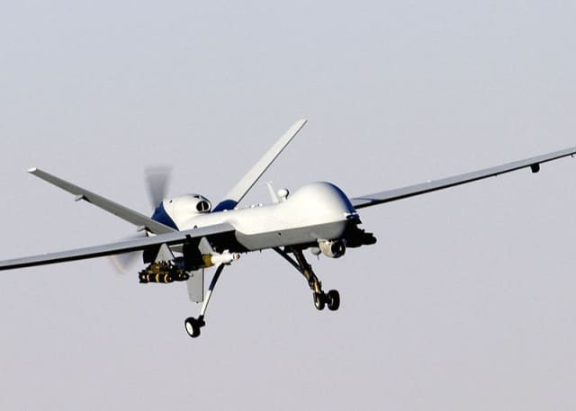
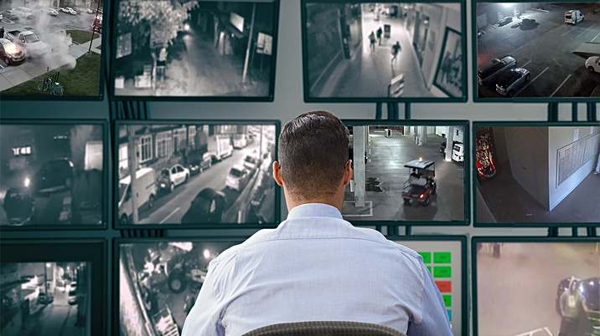
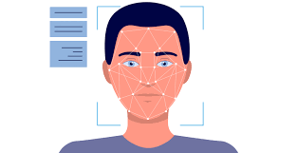
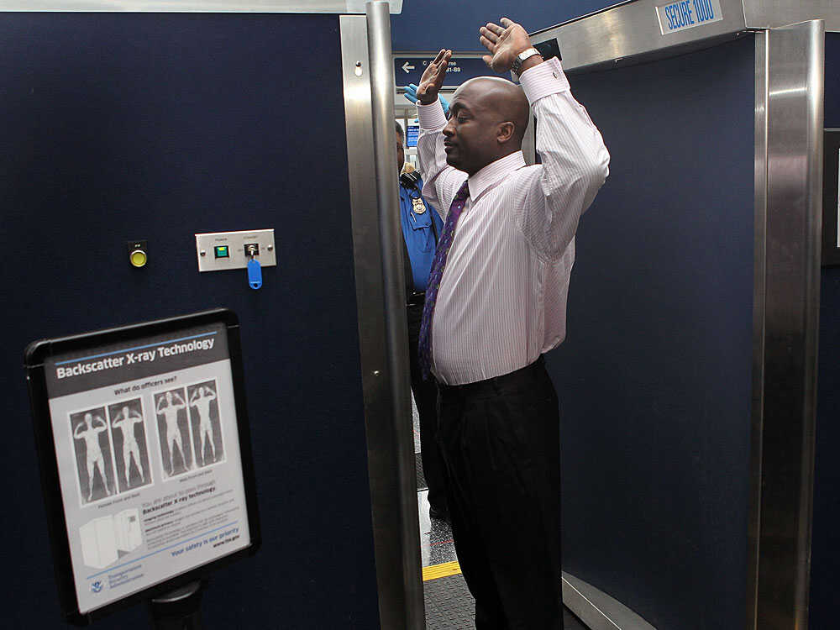
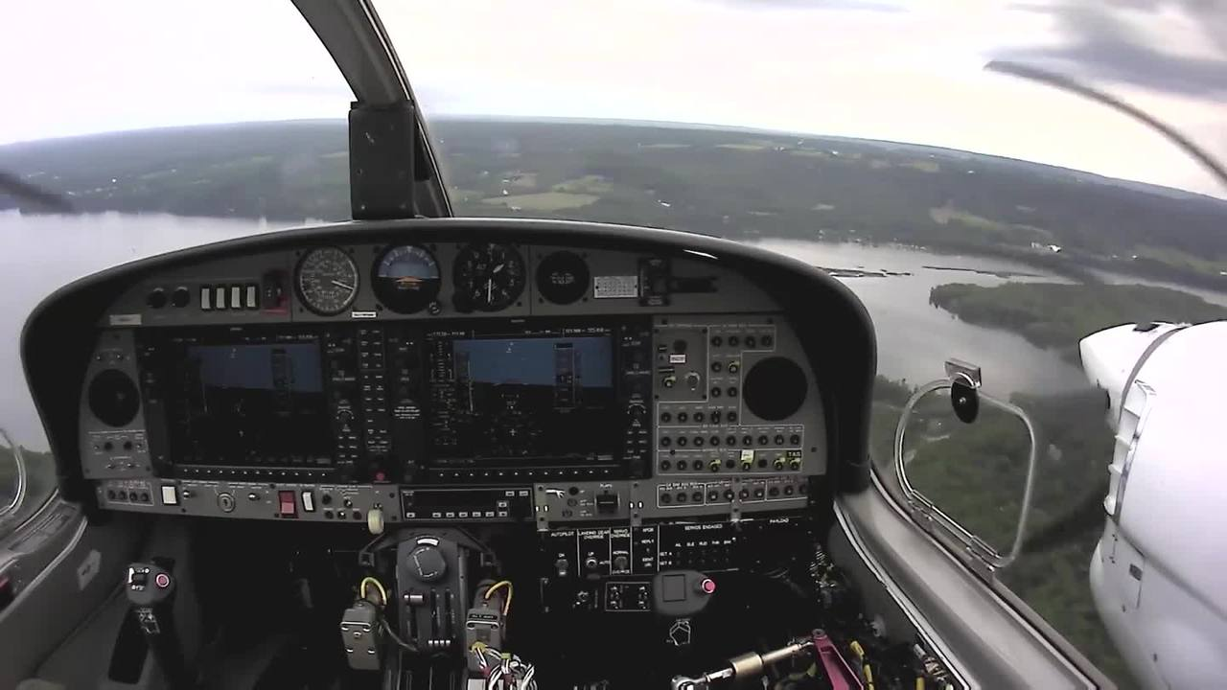
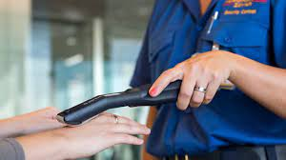
Remote Video Monitoring
Drones
Data Collection and Analytics
Remote-Controlled Airliners
Bio-monitors

Slide 4
Are these the same man?
What are the similarities and differences between them?
Notes:
Classroom discussion:
facial recognition is not as easy as it seems.
A computer can match two images pixel-by-pixel to check if there is an exact match. However, in real life a person can look different due to different facial expressions, hair color, cutting hair or shaving, clothing, etc. Humans can readily recognize faces. (usually) because our brain extracts and matches key features of the person inside the photos. For example, President Obama is black while President Biden is white. The goal of this activity is to illustrate new tools that came about after 9/11 and to explore AI concepts of feature extraction – conversion of data in the original format (for example, an image) into a series of quantitative or qualitative features that can be used to distinguish different objects in the original data.- and database search. A computer cannot ‘see' a photo like a human, but it is good at comparing a list of features.
By converting the original image into a series of features, a computer can behave like humans in terms of recognizing the person inside each photo.

Slide 5
After the passing of Congressman John Lewis, Florida Senator Marco Rubio, went on Twitter to honor him. This is what happened:

Slide 6
Are these the same man?
What are the similarities and differences between them?
Elijah Cummings
John Lewis
Notes:
Classroom discussion:
These are pictures of Elijah Cummings (left) and John Lewis (right). They were both Congressmen in the House of Representatives of the US. They both passed away: Elijah Cummings on October 17, 2019 and John Lewis on July 17, 2020. Many politicians went on Twitter to offer condolences and honor them after the fact. But when John Lewis passed away, Senator Marco Rubio (from Florida) posted a picture of himself with the late Elijah Cummings instead.
Classroom discussion:
facial recognition is not as easy as it seems.
A computer can match two images pixel-by-pixel to check if there is an exact match. However, in real life a person can look different due to different facial expressions, hair color, cutting hair or shaving, clothing, etc. Humans can readily recognize faces. (usually) because our brain extracts and matches key features of the person inside the photos. For example, President Obama is black while President Biden is white. The goal of this activity is to illustrate new tools that came about after 9/11 and to explore AI concepts of feature extraction – conversion of data in the original format (for example, an image) into a series of quantitative or qualitative features that can be used to distinguish different objects in the original data.- and database search. A computer cannot ‘see' a photo like a human, but it is good at comparing a list of features.
By converting the original image into a series of features, a computer can behave like humans in terms of recognizing the person inside each photo.

Slide 7
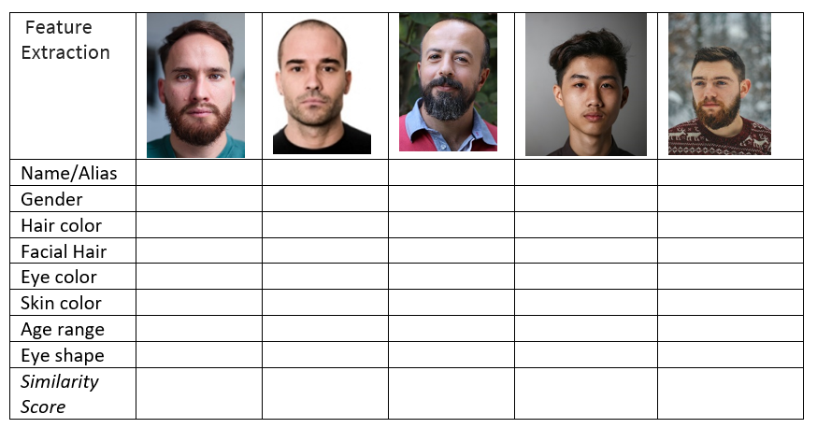
Part 1: Feature Extraction

Slide 8
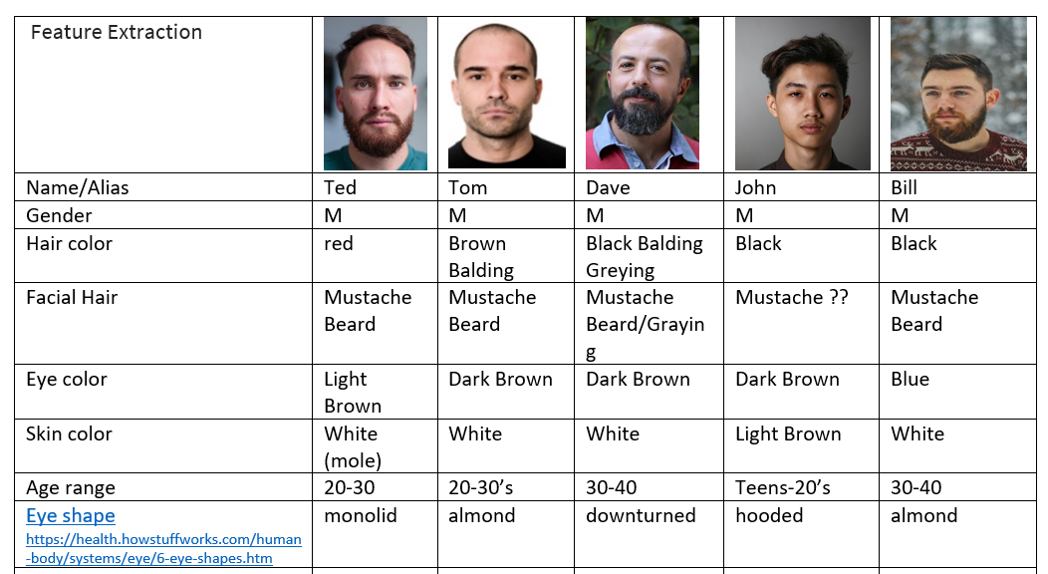
Part 1: Feature Extraction

Slide 10
Part 2: Database Search

Slide 11
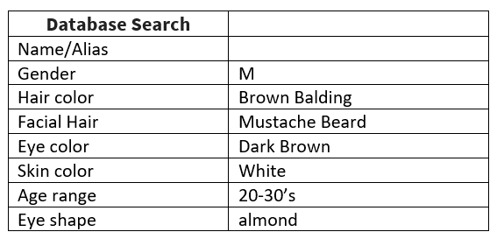
Part 2: Database Search

Slide 12
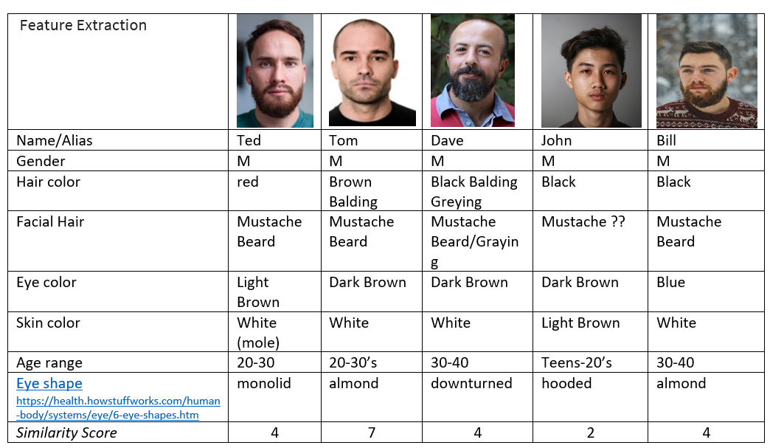
Part 1: Feature Extraction

Slide 13
Part 1: Feature Extraction

