Slide 1
Sorting Network

Slide 2
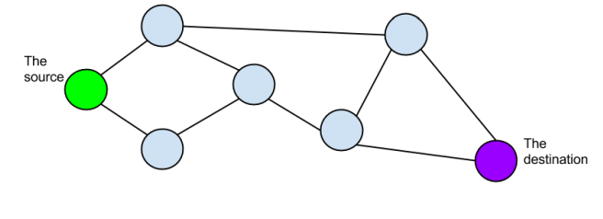
What is the shortest number of ‘hops’ your packet needs to take to get from the source to the destination?
Notes:
From https://tryengineering.org/wp-content/uploads/Networks.pdf
Shortest hops = 3 going along the top part of the graph.

Slide 3
What is the longest path it could take, if it doesn’t loop or return to the source?
Notes:
The longest number of hops is six.
Right
Up/right
Left
Right
Right
left

Slide 4
Is there any vertex that is an articulation point, that is, if it were removed, the packet couldn’t get from the source to the destination?
What if you remove a vertex, does this create an articulation point?
Notes:
No
IF you are allowed to move back you can still get to the destination. Some make it harder/longer but not impossible.

Slide 5
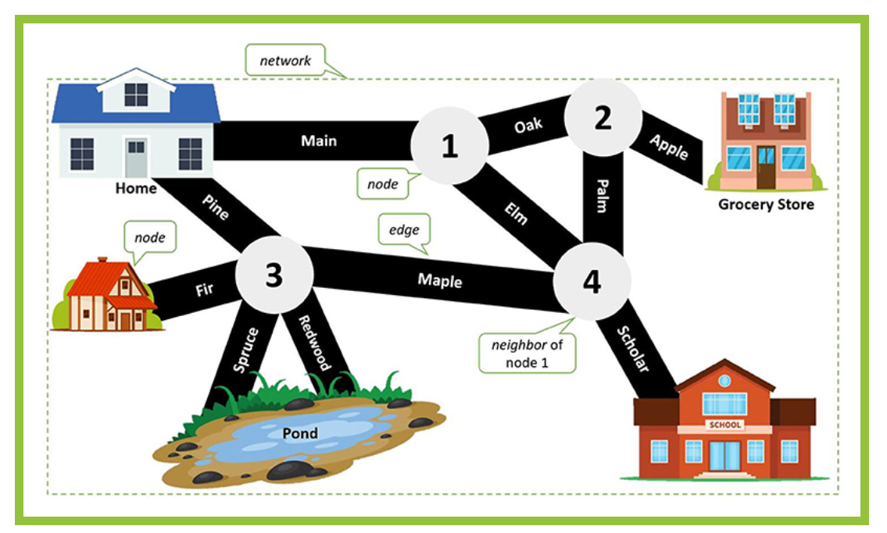
What paths can be taken to get from Home to School?
Notes:
Least number of hops = Pine—Maple—Scholar or Main to Elm to Scholar

Slide 6
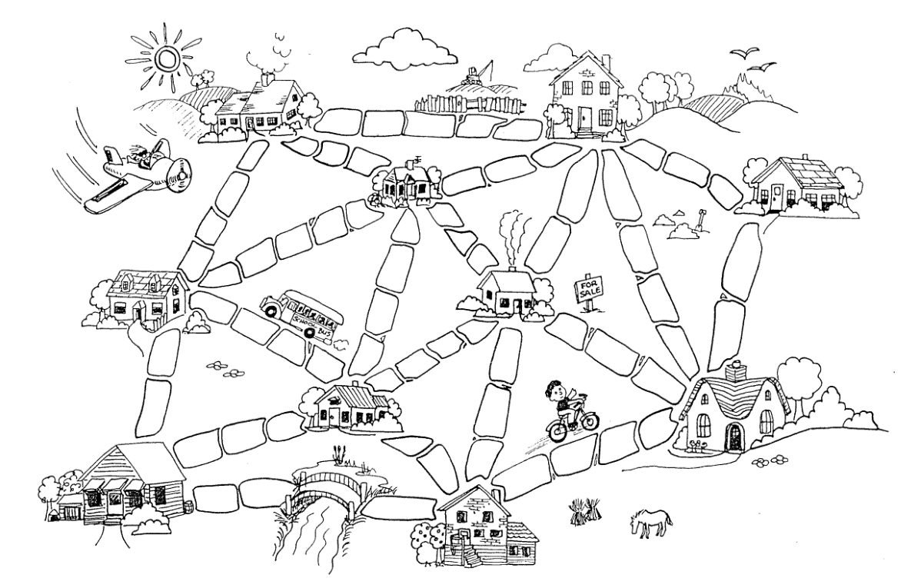
Notes:
From Muddy City problem
Good explanation @ Solving the Muddy City Problem with Minimum Spanning Tree | edward-huang.com

