Slide 1
National Milk Day
Cybersecurity and Chemistry/Science

Slide 2
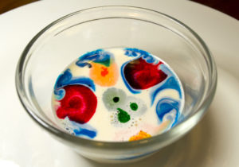
Magic Milk
Notes:
3 Fun Milk Science Experiments - The Dairy Alliance

Slide 3
Ingredients
milk
food coloring
dish soap
cotton swabs
bowl

Slide 4
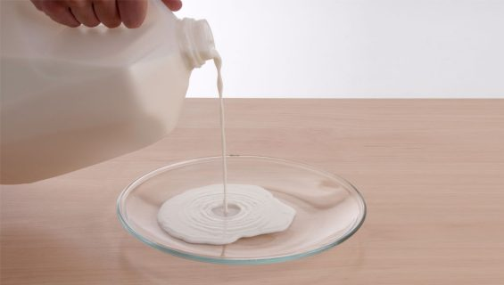
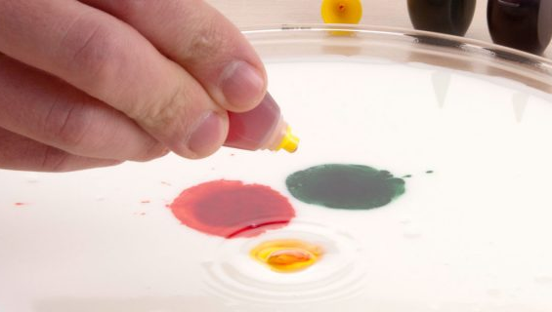
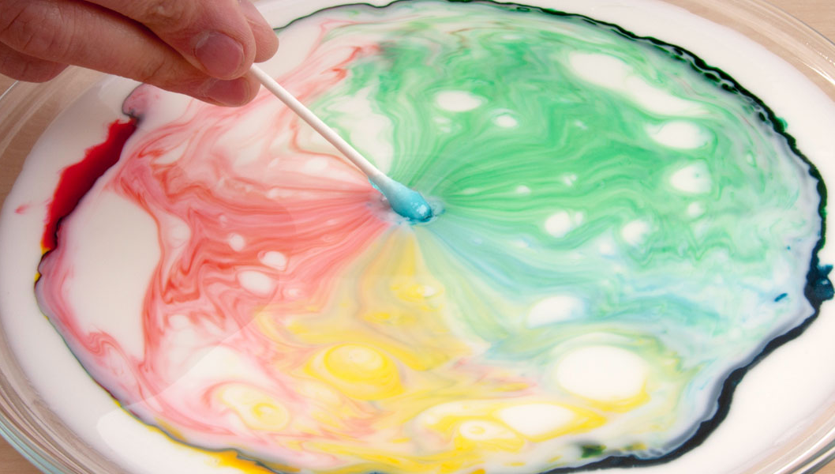
Directions
Pour milk into a bowl.
Grab food coloring (the more colors the better) and dot the surface of the milk.
Next, dip the cotton swab in the dish soap.
Place the swab on the dotted milk and watch the colors jump across the bowl as the dish soap tries to attach itself to the milkfat!
Notes:
Color Changing Milk Experiment - Magic Milk Experiment | Science Experiment (stevespanglerscience.com)

Slide 5
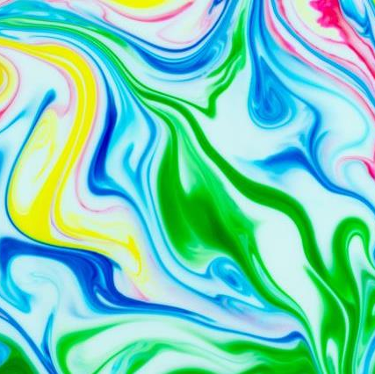
CREATE A MILK MASTERPIECE
See what happens when dish soap tries to attach to the milkfat, creating fireworks wherever it comes in contact with the milk.
For those bursts of color worthy of a place on the refrigerator, transfer the art from bowl to paper. (Use a tray instead of a bowl with just enough milk to cover the bottom for an easier transfer.)
Once satisfied with their creation, place a sheet of paper over the design and press it down into the milk. Remove the paper and allow it to dry before displaying the artwork for all to see on their next trip to the kitchen.
Notes:
Color Changing Milk Experiment - Magic Milk Experiment | Science Experiment (stevespanglerscience.com)
untitled (weebly.com)
Redesign (chemed.org)

Slide 6
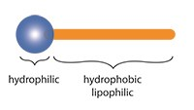
How does the soap and milk experiment work?
When liquid dish soap is added to milk with drops of food coloring on the surface, the soap reduces the surface tension of the milk and reacts with the fat. This interaction causes the fat particles in the milk to move and create swirls of color.
Soap is a surfactant, which reduces the surface tension of the milk and allows the food coloring to move around the milk
Soap is a natural surfactant. A surfactant is any substance that tends to reduce the surface tension of a liquid in which it is dissolved.
Almost all cleansing products are based on surfactants. Surfactants not only reduce the surface tension of the water but the way they are constructed (with one hydrophilic end and one hydrophobic end) makes them compatible with both water and oils.

Slide 7
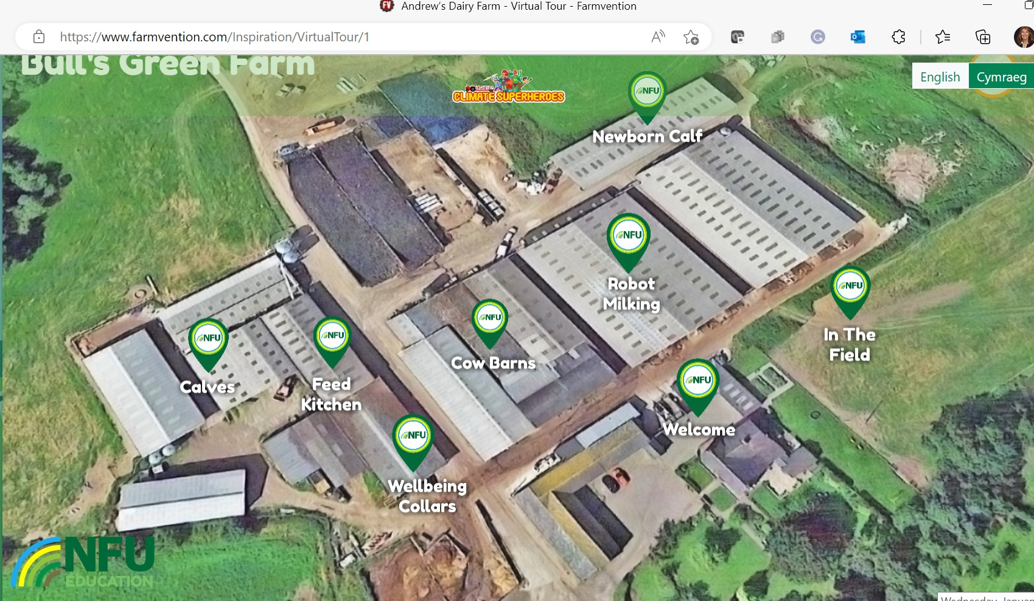
Cybersecurity in the food and agriculture industry
Notes:
Andrew’s Dairy Farm - Virtual Tour - Farmvention

Slide 8
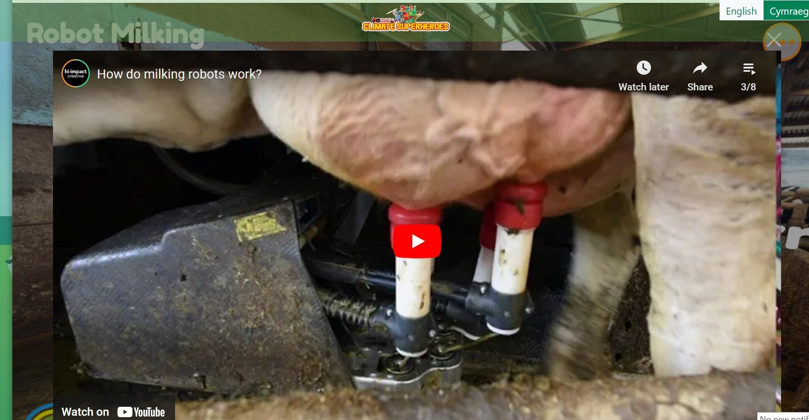
Notes:
(892) Robotic Milking: How the Technology Works - YouTube

Slide 9
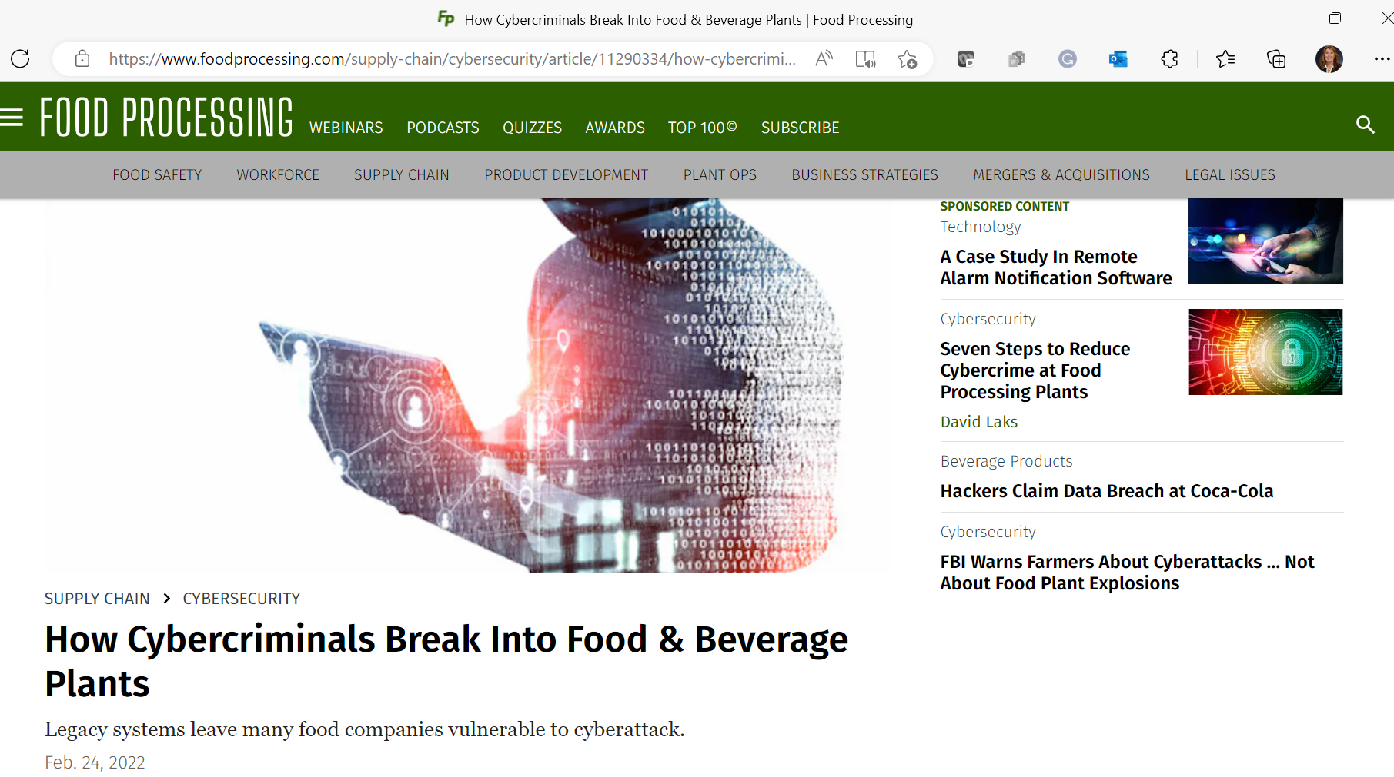
Notes:
How Cybercriminals B
Get Ready for Cyber-Attacks on Global Food Supplies | WIRED UK
reak Into Food & Beverage Plants | Food Processing

Slide 10
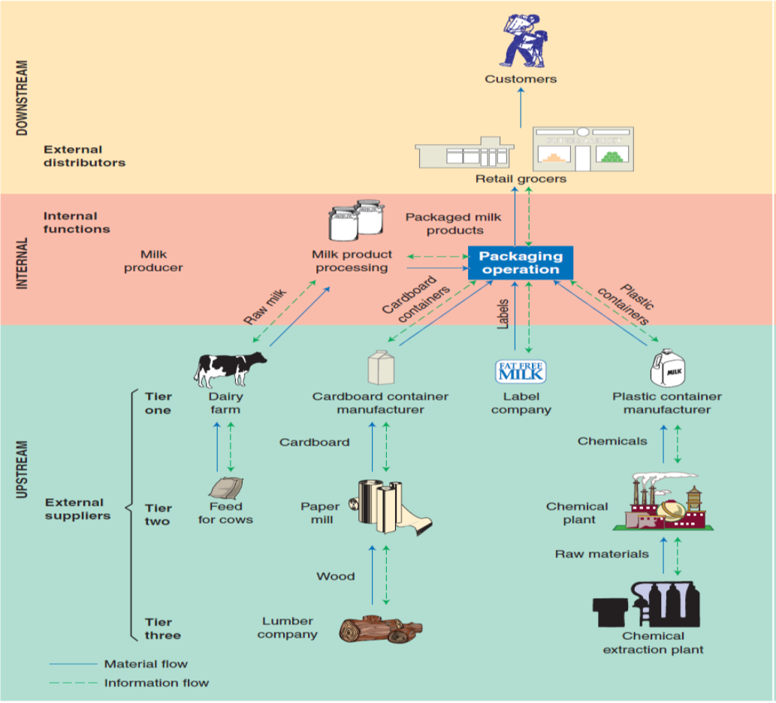
What could go wrong in the dairy supply chain?

Slide 11
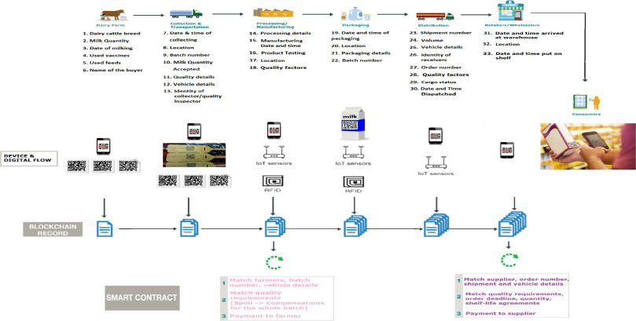
Notes:
Milk Moovement - Dairy Supply Chain Software
Supply chain challenges guide (rsmus.com)
From Farm to Fork: The Dairy Supply Chain (smartsense.co)

Slide 12
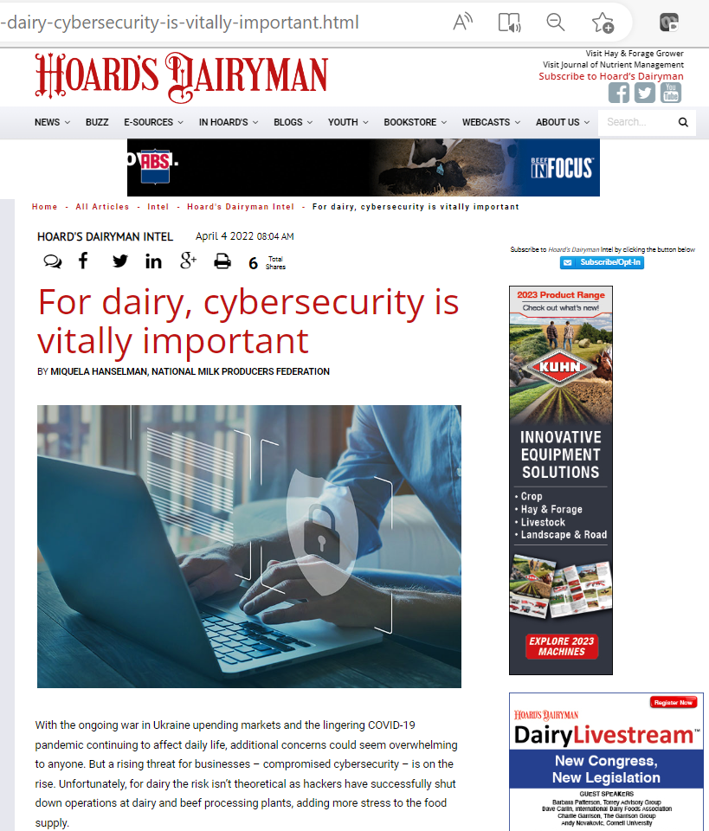
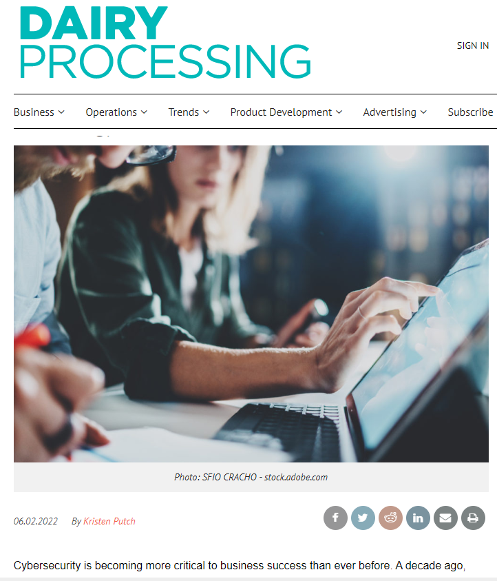
Notes:
For dairy, cybersecurity is vitally important (hoards.com)
Risks loom as dairy industry leans into new technology | Dairy Processing

