Slide 1
January: Mentoring Month
Notes:
January is National Mentoring Month.

Slide 2
www.nationalmentoringresourcecenter.org
Notes:
www.nationalmentoringresourcecenter.org

Slide 3
This review examines research on the role of mentoring on career interest and exploration for adolescents under 18 years of age. Four questions:
What are the effects of mentoring on career interests and exploration (CIE) among youth?
What factors condition or shape the effects of mentoring on CIE?
What intervening processes are most important for linking mentoring to beneficial effects on CIE?
To what extent have efforts to provide mentoring to youth with CIE as a priority outcome reached and engaged the intended youth, been implemented with high quality, and been adopted and sustained by host organizations and settings?

Slide 4
Some Key Findings
While a broad range of mentoring programs target CIE outcomes, few programs have been rigorously evaluated for their effects on these outcomes and even less evidence is available concerning whether relatively immediate benefits carry over into later stages of development (career interests at the stage of entering higher education or the workforce).
Mentoring helps middle-schoolers build skills and gain knowledge needed for positive CIE outcomes related to social-emotional, academic, and cognitive skills, and overcoming barriers) whereas older youth, who are closer to entering the job market, benefit more from mentor support around career decision-making.
Self-efficacy and perception of “future-self” appear to be important to the processes by which mentoring improves youth career aspirations. However, reducing social barriers and strengthening social connections are just as important.

Slide 5
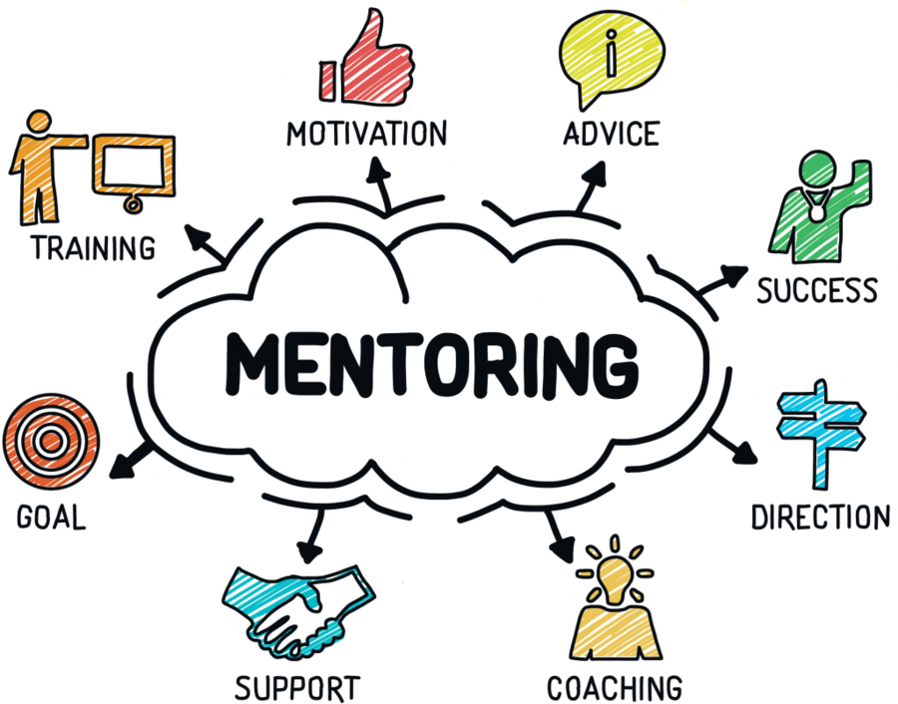
All mentoring programs—whether career-oriented or not—should be aligned with both the developmental and career stages of the mentees they serve.

Slide 6
Progression of age-related developmental changes that influence children’s career development
Younger participants: CIE programs should focus primarily on exposing them to different careers and piquing their interest
Middle youth: CIE programs should focus on solidifying career interests (narrow focus), building career-relevant skills needed for positive outcomes (social-emotional, academic, and cognitive skills), and supporting youth in overcoming barriers in pursuit of their desired career
Mentoring programs for older youth are more likely to target students with pre-existing interests, with the goal of maintaining that interest and engagement over time

Slide 7
Developmental Progression Among Young Persons
Initial identification of possible careers or industries of interest
Gather more information and narrow fields of interest
Engage in more hands-on learning and skill-building in a focused career path or ladder

Slide 8
Matching on career or personal interests is just as important or more important than matching on other background characteristics. For example, if a mentee is looking to develop a specific skill, or is seeking exposure to a specific career, finding a mentor based on race or gender may be of lower importance than finding a mentor with the appropriate occupational background.
Utilizing same-sex mentors, specifically for female youth with an interest in traditionally male-dominated fields, may be critical in maintaining female engagement in those fields.
Quality mentor training and continued program support may be an effective means through which mentoring leads to both high quality mentoring relationships and improved CIE outcomes.

Slide 9
Don’t assume that young people of a certain group need or want to go into particular fields. This review mentions an example from a study where youth of color were strongly encouraged to participate in a STEM mentoring program — unfortunately many of them didn’t care much for STEM subjects and were not interested in those careers from the outset.
While one could argue that finding out a career in a field is not right for you is a good outcome, it’s also possible that programs can wind up pushing youth into careers where they may be underrepresented (hoping to address those diversity gaps) rather than letting the young person genuinely explore and find careers that fit their values, interests, and talents.
A program making assumptions about careers youth “should” consider from an adult or industry perspective may miss the mark of a broader exploration experience that some young people may benefit from. There is a tension practitioners should consider between wanting to help youth explore careers they may never have considered but also trying to avoid pushing youth toward careers that genuinely aren’t a good fit for them.

Slide 10
Sample of National Mentoring Resource Center’s career exploration mentoring program resources:
College and Career Success Mentoring Toolkit - provides guidance on the development of mentoring programs that promote college and career success or youth. It reviews key elements of program design, recruiting and supporting mentors and mentees, and provides examples of relevant programming and data tools.
Discovering the Possibilities: “C”ing Your Future – a 12-module curriculum and activity guide is designed to assist mentors in working with middle school youth to explore postsecondary education and possible careers.
STEM Mentoring Supplement to the Elements of Effective Practice for Mentoring - This resource outlines recommendations and research-informed practices for STEM mentoring programs.
Workplace Mentoring Supplement to the Elements of Effective Practice for Mentoring - This resource outlines recommendations and research-informed practices for workplace mentoring programs.
Notes:
https://nationalmentoringresourcecenter.org/resource/college-and-career-success-mentoring-toolkit/
https://nationalmentoringresourcecenter.org/resource/discovering-the-possibilities-cing-your-future/
https://nationalmentoringresourcecenter.org/resource/stem-mentoring-supplement-to-the-elements-of-effective-practice-for-mentoring/
https://nationalmentoringresourcecenter.org/resource/workplace-mentoring-supplement-to-the-elements-of-effective-practice-for-mentoring/

Slide 11
https://nationalmentoringresourcecenter.org/research-tools/evidence-reviews/

Slide 13
How can insights from research in other disciplines support mentoring youth in cybersecurity career programs?

