Slide 1
CyberSnack
Notes:
K12 Cybersecurity Education

Slide 2
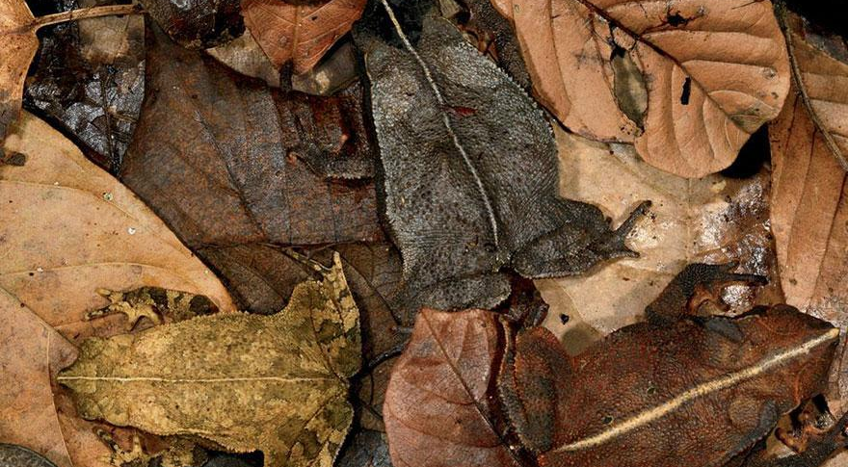
HAPPY FALL
The Week Ahead: Veterans Day
Notes:
http://www.kickvick.com/camouflaged-animals/
Mystery Science

Slide 3
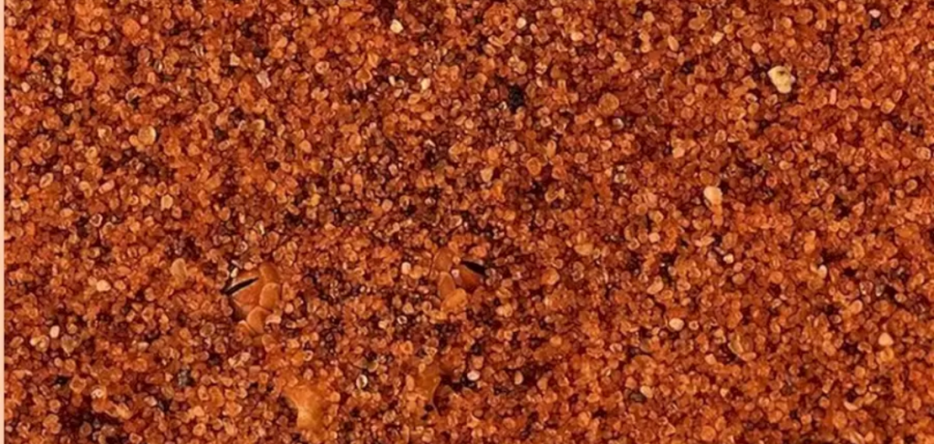
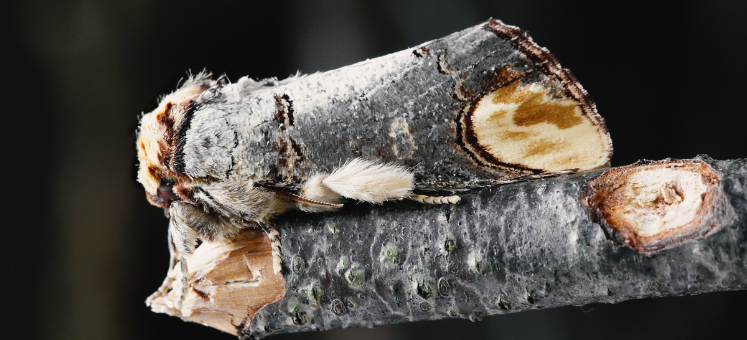
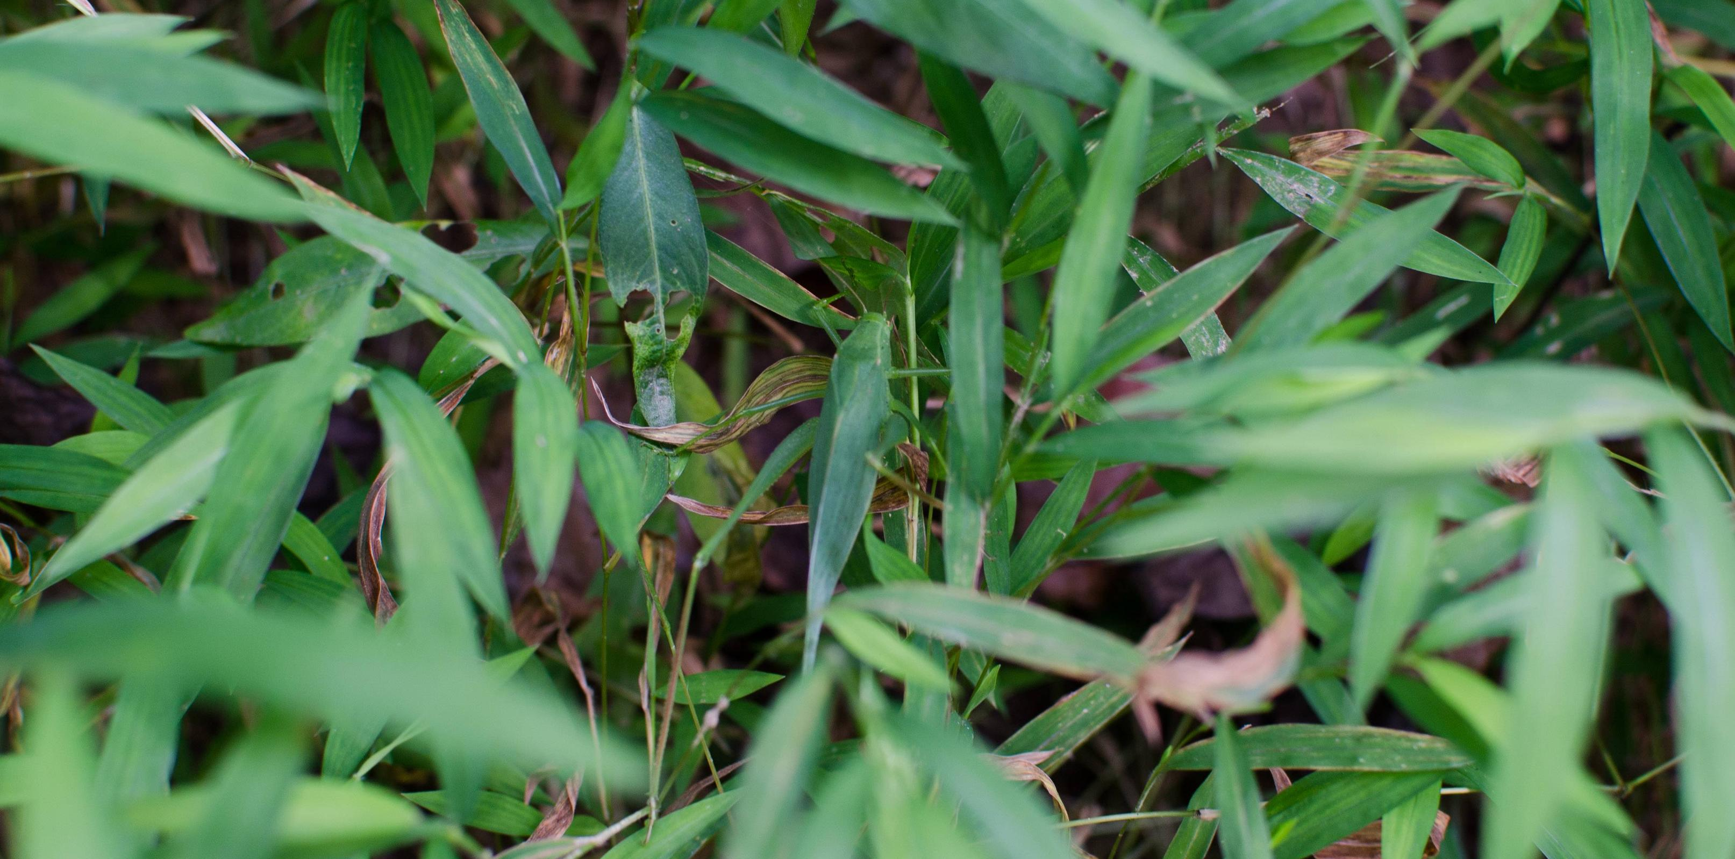
This Photo by Unknown Author is licensed under CC BY-SA
Notes:
https://docs.google.com/presentation/d/1qkg8fssGnhNOO3IxUI87GRLZcz10X6N4pKEirPSdZss/htmlpresent

Slide 4
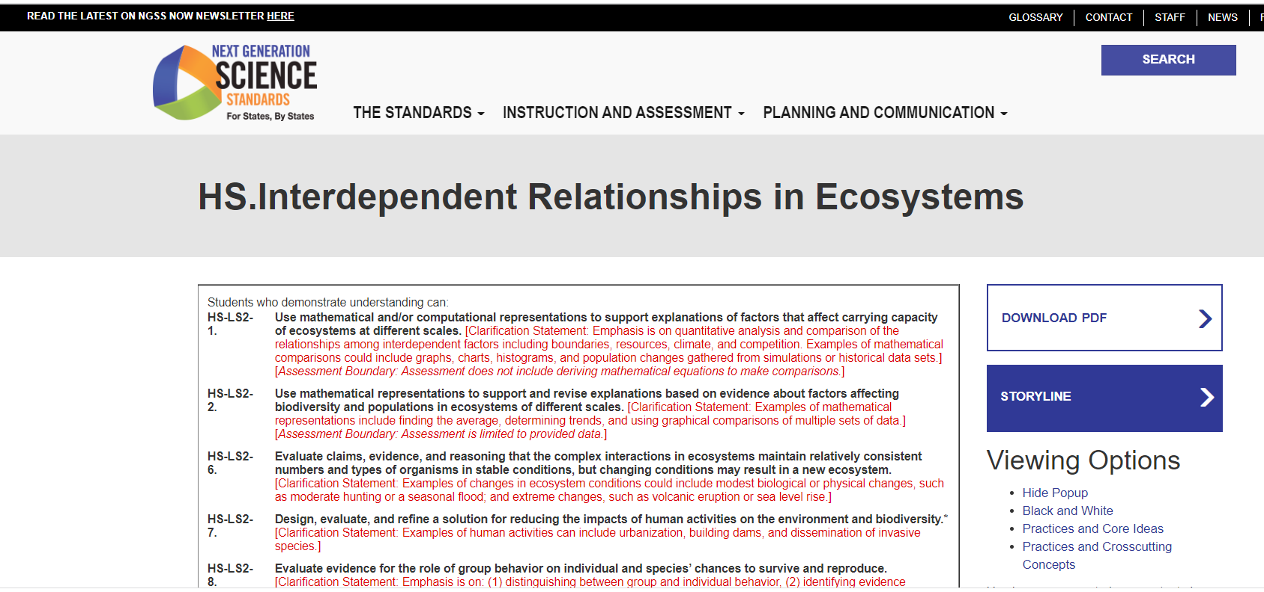
Integration into K12 Core Subjects and Standards

Slide 5
Notes:
http://www.kickvick.com/camouflaged-animals/

Slide 6
This Photo by Unknown Author is licensed under CC BY-SA
Notes:
https://docs.google.com/presentation/d/1qkg8fssGnhNOO3IxUI87GRLZcz10X6N4pKEirPSdZss/htmlpresent

Slide 7
Embedding Messages Within Other Text
Null ciphers (unencrypted messages). The real message is "camouflaged" in an innocent sounding message.
Apparently, neutral's protest is thoroughly discounted and ignored. Isman hard hit. Blockade issue affects pretext for embargo on by products, ejecting suets and vegetable oils.
Source: http://www.jjtc.com/stegdoc/sec202.html

Slide 8
The following message was actually sent by a German Spy in WWII
Apparently neutral's protest is thoroughly discounted and ignored. Isman hard hit. Blockade issue affects pretext for embargo on by products, ejecting suets and vegetable oils.
Taking the second letter in each word the following message emerges:
Pershing sails from NY June 1
Source: http://www.jjtc.com/stegdoc/sec202.html

