Slide 1
CyberSnack
Notes:
National K12 Cybersecurity Education ROADMAP

Slide 2
August
August 16 is
National Tell a Joke Day

Slide 3
Why didn’t the IT team set up their remote office from the beach?

Slide 4
Why didn’t the IT team set up their remote office from the beach?
ANSWER: It was too cloudy.

Slide 5
What’s a hacker’s favorite season?

Slide 6
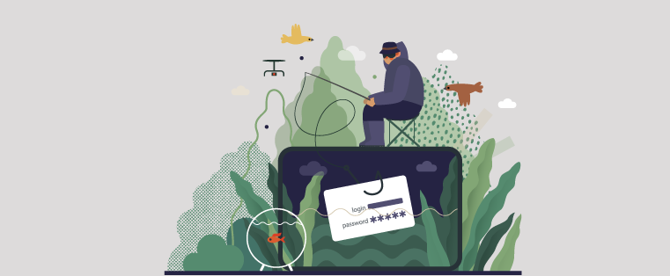
What’s a hacker’s favorite season?
ANSWER: Phishing season

Slide 7
What do you call an excavated pyramid?

Slide 8
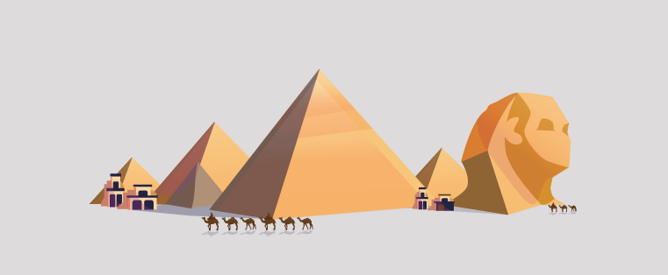
What do you call an excavated pyramid?
ANSWER: Unencrypted.

Slide 9
What do you call a group of math and science geeks at a party?

Slide 10
What do you call a group of math and science geeks at a party?
ANSWER: Social engineers

Slide 11
Why did the programmer leave the camping trip early?

Slide 12
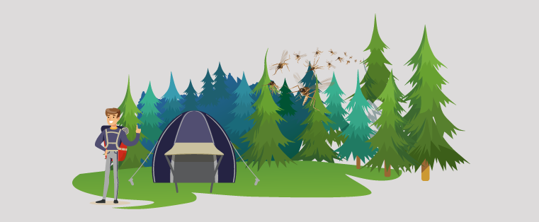
Why did the programmer leave the camping trip early?
ANSWER: There were too many BUGS

Slide 13
What did the hacker’s out of office message say?

Slide 14
What did the hacker’s out of office message say?
ANSWER: Gone phishing!

Slide 15
Where does a MySQL database go to relax on a hot day?

Slide 16
Where does a MySQL database go to relax on a hot day?
ANSWER: A buffer pool.

Slide 17
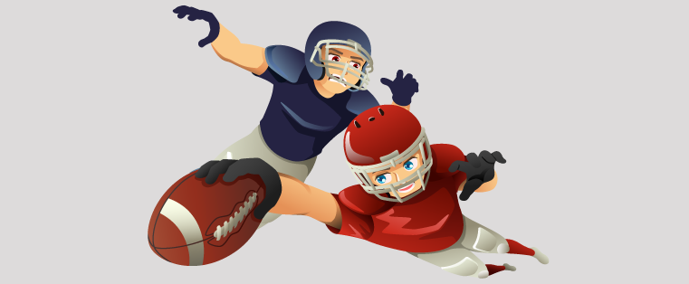
Why did the football team fumble the handoff?

Slide 18
Why did the football team fumble the handoff?
ANSWER: They didn’t use a secure transfer method.

Slide 19
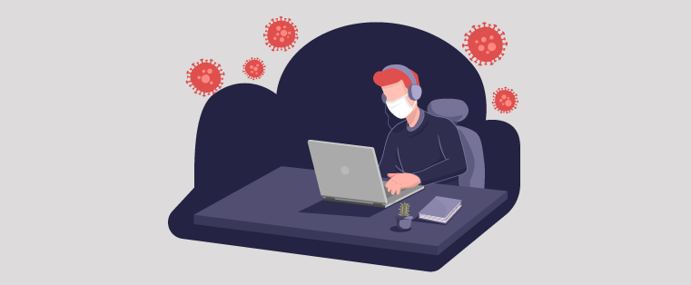
Coronavirus fear is everywhere…
Today I coughed on my monitor and my antivirus software started running
Notes:
The 9+ Best Antivirus Jokes - ↑UPJOKE↑

Slide 20
What do you call it when only one digit steers your car?

Slide 21
What do you call it when only one digit steers your car?
ANSWER: A thumb drive.

Slide 22
What's a secret agent's go-to fashion?

Slide 23
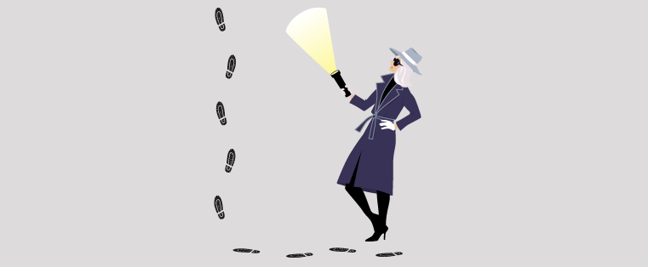
What's a secret agent's go-to fashion?
ANSWER: Spyware

Slide 24
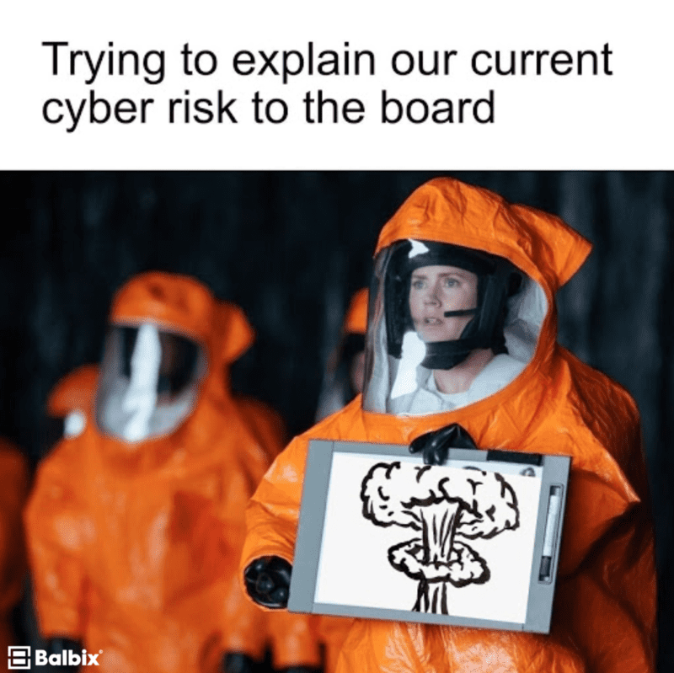

Slide 25
Where did the cybersecurity team go the last few days? .

Slide 26
Where did the cybersecurity team go the last few days? .
ANSWER: They ran-som-ware

Slide 27
What do you call it when computer science majors make fun of each other?

Slide 28
What do you call it when computer science majors make fun of each other?
ANSWER: Cyber boolean!

Slide 29
I needed a password eight characters long so I picked…. SnowWhiteandtheSevenDwarves.
I love the F5 key.
It's just so refreshing.
99 little bugs in the code, 99 little bugs, Take one down, patch it around, 117 little bugs in the code.

