Slide 1
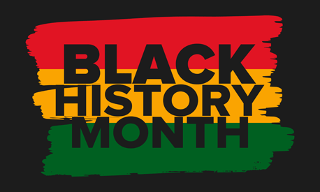
Cybersecurity Connection with Art and History

Slide 2
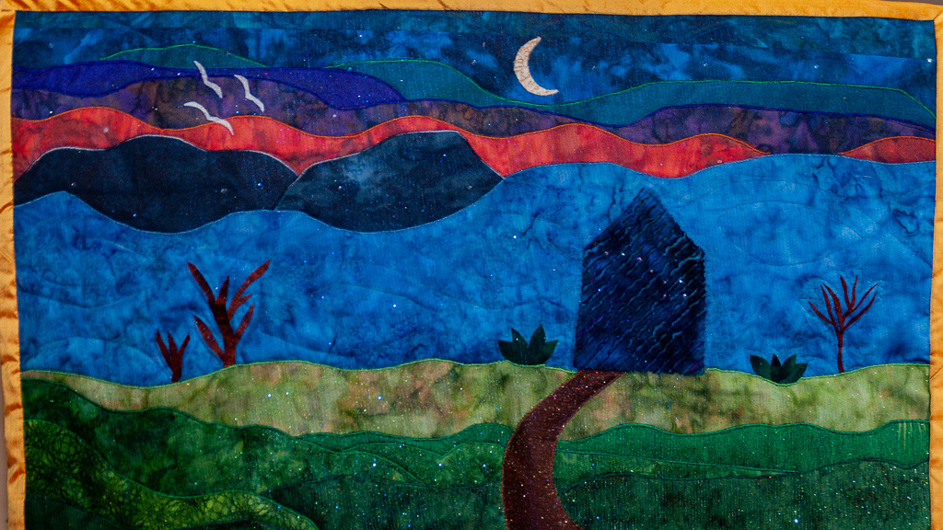
Steganography
the practice of concealing messages or information within other nonsecret text or data
Notes:
The Underground Railroad is an important part of American history—yet it is difficult for children to understand what the Underground Railroad was and how African slaves, known as fugitives, “rode” it to freedom. This quilt poster and guide is packed with ideas for helping children study the Underground Railroad by learning about the quilts—and the secret escape codes quilters stitched into them to guide their people to freedom.
154227.pdf (reallygoodstuff.com)
Pathways to Freedom | Secrets: Signs and Symbols | The Secrets of Quilts (thinkport.org)
She Buys An Ordinary Old Quilt — But Its Hidden Secret? AMAZING! | LittleThings.com

Slide 3
CyberSnacks
Share these two images and have students discuss what they mean to them.
If the images were supposed to be a “secret message” what do you think each would mean?
Notes:
Quilt Codes
Quilt Codes (osblackhistory.com)
Underground Railroad Quilt Block Meanings - HubPages
Click to enlargeFlying Geese: A signal to follow the direction of the flying geese as they migrated north in the spring. Most slaves escaped during the spring; along the way, the flying geese could be used as a guide to find water, food and places to rest. The quilt maker had flexibility with this pattern as it could be used in any quilt. It could also be used as a compass where several patterns are used together. Click to enlargeNorth Star: A signal with two messages--one to prepare to escape and the other to follow the North Star to freedom in Canada. North was the direction of traffic on the Underground Railroad. This signal was often used in conjunction with the song, “Follow the Drinking Gourd”, which contains a reference to the Big Dipper constellation. Two of the Big Dipper’s points lead to the North Star. Click to enlargeMonkey Wrench: A signal to gather all the tools required for the fleeing slave’s journey, meaning the physical tools, as well as the mental and spiritual ones. Click to enlargeSailboat: A signal that either a body of water was nearby or that boats were available. Click to enlargeDrunkard’s Path: A warning signal to take a zigzag route to elude pursuing slave hunters and their hounds that are in the area. A slave spotted travelling south, for instance, would not be suspected of escaping. Click to enlargeDresden Wheel: It is possible that the Dresden Plate could be a variation of the Wagon Wheel. Records indicate that the Dresden Plate quilt pattern did not emerge until the 1920s.Wagon Wheel/Carpenter's Wheel: A signal to the slave to pack the items needed to travel by wagon or that could be used while travelling. It could also mean to pack the provisions necessary for survival, as if packing a wagon for a long journey, or to actually load the wagon in preparation for escape. Some records indicate this symbol meant a wagon with hidden compartments in which slaves could conceal themselves, would soon be embarking for the trip to freedom.
Wagon Wheel Variation:Crossroads: A symbol referring to Cleveland, Ohio, which was the main crossroads with several routes to freedom. On a less literal level, the term “crossroads” also means reaching a turning point in one’s life, where a choice must be made and then carry on.Bear's Paw: Follow a mountain trail, out of view, and then follow an actual bear’s trail which would lead to water and food.Bow Tie (or Hourglass): A symbol indicating it was necessary to travel in disguise or to change from the clothing of a slave to those of a person of higher status.Shoofly: A symbol that possibly identifies a person who can guide and help; a person who helped slaves escape along the Underground Railroad and who knew the codes.Tumbling Blocks or Boxes: A symbol indicating it was time for slaves to pack up and go, that a conductor was in the area.Broken Dishes: A symbol referring to a signal that involved broken crockery at some future landmark.Britches: A symbol indicating the escaping slave needed to dress as a free person.Rose Wreath: A symbol that indicated someone had died on the journey. It was an African tradition to leave floral wreaths on the graves of deceased.
Log Cabin: A symbol in a quilt or that could be drawn on the ground indicating it was necessary to seek shelter or that a person is safe to speak with. Some sources say it indicated a safe house along the Underground Railroad.
Double Wedding Ring: This pattern did not exist until after the American Civil War. However, the Double Irish Chain pattern did and is believed to have symbolized the chains of slavery. When a slave saw this quilt displayed, it meant the rings or shackles of slavery could be removed. When marrying, slaves did not exchange wedding rings; they “jumped the broom”.

Slide 4
Notes:
Sailboat - This pattern was the symbol of safe water passage to freedom. Free black sailors and ship owners helped many slaves escape directly, hiding them on board ships and spiriting them away to Canada.

Slide 5
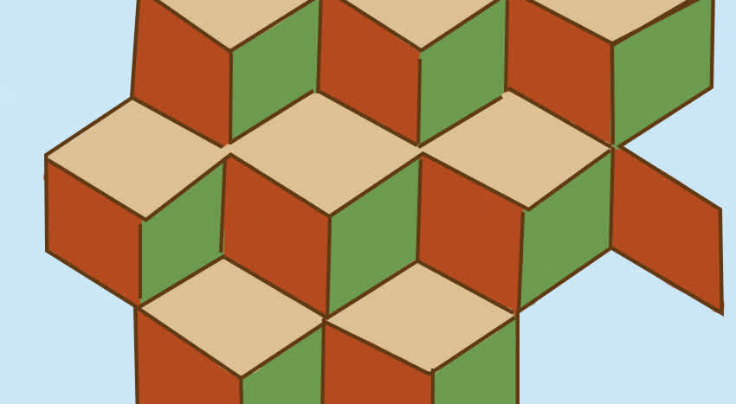
Notes:
Tumbling Blocks or Boxes: This was a symbol indicating that it was time for slaves to pack up and go because a conductor was in the area.

Slide 6
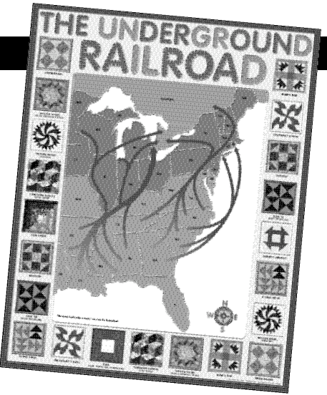
Art Standards: (grade 5-8 )
Anchor Standard 10:
Synthesize and relate knowledge and personal experiences to make art. Act on creative ideas to connect personal experiences and knowledge to visually represent what people see, know, feel and imagine.
Anchor Standard 11: Relate artistic ideas and works with societal, cultural, and historical context to deepen understanding. Reason effectively to understand the role of art as an essential aspect of history, society, culture and human experience.

Slide 7
CREATE YOUR OWN SECRET MESSAGE
After discussing information about Black History Month, the Underground Railroad and secret codes hidden in plain site, have them create their own secret symbol.
Offer art supplies (crayons, markers, assorted paper, wrapping paper, fabric scraps and scissors).
Tell children to create quilt squares with hidden meanings. Remind them that colors, patterns, textures, “stitches” and “knots” (drawn on with a fine line marker), can each indicate a coded symbol.
Students can create individual squares which may be taped or quilted together as a class quilt, or they may create individual quilts by gluing a number of completed squares to lengths of craft paper which can then be displayed on walls and hallways.
Notes:
Underground Railroad Symbols for kids: Quilt Codes
NOTE: Code Quilts – Objects as Texts (brown.edu)
Unsubstantiated theories has been offered that quilts were made containing Underground Railway symbols. The use of symbols on quilts were said to be an effective way for slaves to communicate nonverbally with each other and help each other to escape. This does make some sense in relation to quilts being hung on clotheslines. Symbols used to indicate routes:
● Geese symbols flying North ● Crossroads symbols that indicated Cleveland, Ohio ● Bears Paw symbols conveying a message to take a mountain route ● Bow tie symbols meaning it would be necessary to change from slave clothing ● Broken dish symbols which would be used as directional symbols along the escape route ● Symbols of log cabins told slaves to look for this symbol on their journey to freedom ● Box symbols that indicated it was time to pack (box-up) ready to escape ● Patterns called a monkey wrench were were symbols reminding slaves to prepare for the journey taking weapons or tools that would help on their journey ● North Star symbols indicating the way to freedom
Underground Railroad Symbols Facts for kids - Railways
Underground Railroad Symbols: Code words and phrases relating to Religion Just as the American railroads provided secret words and symbols relating to the "Underground Railroad" it was also safe to apply religious words, signs and symbols to extend the vocabulary of the organization. The words, phrases and symbols used in the "Underground Railroad" relating to religion were as follows:
Underground Railroad Symbols for kids - Religious
Words, Signs and Symbols - Meaning and Definition
Canaan - Canaan was a biblical term used to mean Canada
Heaven - The word used to describe the destination of a fugitive, usually referring to CanadaPreachers - Abolitionists or leaders of the "Underground Railroad"
River Jordan - The secret code word for the Ohio RiverShepherds - Shepherds were alternative names for Conductors meaning those who guided fugitive slaves between safe houses
Moses - Moses was the code name of Harriet Tubman, the most famous conductorGospel Songs - Gospel songs like "Steal away, steal away, steal away to Jesus", "Swing low, sweet chariot" and "Wade in the Water" were used to indicate that an escape plan was about to be carried out or give reminders to use water to travel by. The song "Follow the Drinking Gourd" was a reminder to follow the North Star - as this would always lead the way to freedom
Words, Signs and Symbols - Meaning and Definition
Underground Railroad Symbols for kids - Religious
Underground Railroad Symbols: Other Code words and phrases Other secret words, phrases and symbols relating to the "Underground Railroad" were also used to extend the vocabulary of the network as follows:
Underground Railroad Symbols and Phrases
Phrases - Meaning and Definition
"The river bank makes a mighty good road" - A reminder to travel by water
"The wind blows from the South today" - An alert that fugitive slaves were in the area"The dead trees will show you the way" - A reminder that moss grows on the North side of dead trees useful when the stars were not visible
"Left foot, peg foot" - A description of a certain conductor"The friend of a friend sent me" - Password used by slave fugitives
Phrases - Meaning and Definition
Underground Railroad Symbols for kids - Religious
Underground Railroad Symbols: Other Useful Words and Phrases Other useful words and phrases associated with the "Underground Railroad" are as follows:
Underground Railroad - Meaning of Useful Words and Phrases
Words and Phrases - Meaning and Definition
Abolitionist - A social reformer in favor of abolishing slavery
Antebellum - Antebellum is the name given to historical era that preceded the Civil WarEmancipation - Emancipation is the act of setting a person free from slavery
Manumission - Manumission the formal act of freeing from slavery. A written legal document freeing a person from slaveryFree States - Free States that did not allow slavery
Slave States - Slave States permitted slavery
The Mason-Dixon Line - The Mason-Dixon Line is the boundary line dividing the northern free states from the southern slave statesThe 'Gag rule' - The Gag Rule was a provision that prevented the discussion of a topic in Congress, such as abolishing slavery
Secession - Secession was the withdrawal of eleven Southern states from the Union in 1860 which precipitated the American Civil WarFugitive Slave Law - The Fugitive Slave Laws were acts passed by Congress in 1793 and 1850 outlawing any efforts to impede the capture of runaway slaves
Mulatto - A word used to describe a child of a black person and a white personWords and Phrases - Meaning and Definition
Underground Railroad - Meaning of Useful Words and Phrases
Black History for kids: Important People and Events For visitors interested in African American History refer to Black History - People and Events. A useful resource for teachers, kids, schools and colleges undertaking projects for the Black History Month.
Underground Railroad Symbols for kids - President Andrew Jackson Video The article on the Underground Railroad Symbols provides an overview of one of the Important issues of his presidential term in office. The following Andrew Jackson video will give you additional important facts and dates about the political events experienced by the 7th American President whose presidency spanned from March 4, 1829 to March 4, 1837.
Underground Railroad Symbols
● Interesting Facts about Underground Railroad Symbols for kids ● Underground Railroad Symbols for kids ● The Underground Railroad Symbols, a Important event in US history ● Andrew Jackson Presidency from March 4, 1829 to March 4, 1837 ● Fast, fun, interesting Underground Railroad Symbols ● Picture of Underground Railroad Quilt Symbols ● Underground Railroad Symbols for schools, homework, kids and children
This website is produced by the Siteseen network that specializes in producing free informative websites on a diverse range of topics.
Underground Railroad Symbols for kids - Railways
Words, Signs and Symbols - Meaning and Definition
Underground Railroad - The name for the secret network of organizations and operations who helped slaves to escape slavery
Railroad Line - Line referred to the route from one safe house to anotherConductor - Conductors were those who guided fugitive slaves between safe houses
Station master - The station master was the owner of a safe houseStation / Depot - Station and Depot were the secret names given to hiding places or safe houses used during escapes
Cargo / Freight - Cargo or Freight was the name given to fugitive slaves who received assistance from conductors on the Underground RailroadPassengers - Passengers was another name give to slaves traveling the escape routes
Baggage - Baggage was another secret name for a fugitive slaveParcels - Term to indicate that fugitive slaves were on their way to a safe house
Stockholders - The name given to abolitionists who donated money, food, shelter and clothing to the Underground RailwayTicket Agents - Agents was the name given to those who coordinated and planned escape routes. Slaves were given a 'ticket'
Operator or Engineer - Other names for a conductor (the guides)Jumping off place - Place of safe shelter for fugitive slaves
Patty Rollers or Paddy Rollers - Patty Rollers, Pattyrollers or Paddy Rollers were slave catchers. Probably a derivation of patrollers but 'Roller rigs' was used for the investigation of steam locomotivesWords, Signs and Symbols - Meaning and Definition

Slide 8
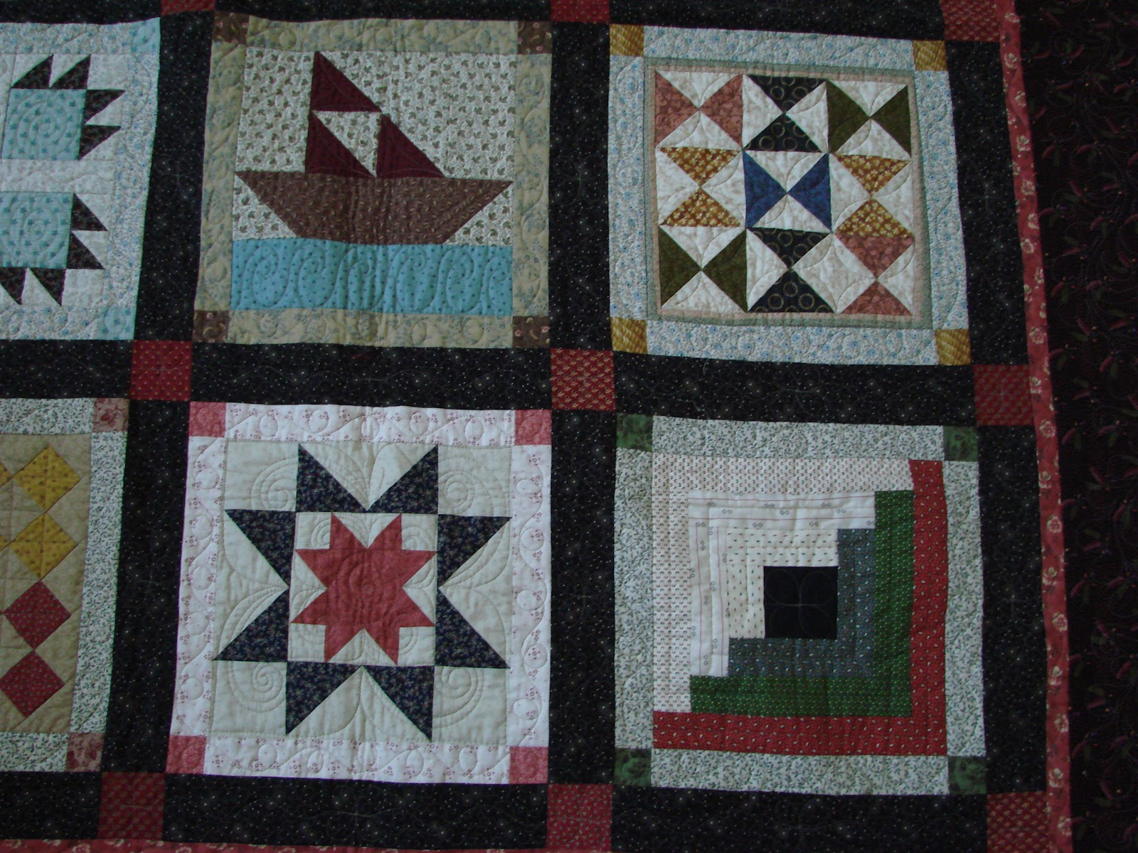
Directions
Design an Underground Railroad Freedom Quilt.
Step 1. Read the background information about the Underground Railroad.
Step 2. Look at the different quilt pattern designs and meanings.
Step 3: Decide on which code patterns you will use and write down the directions for a classmate to follow. Use between 4 and 9 different patterns.
Step 4. On a blank sheet of paper, divide the paper into 9 equal squares that are at least 2 in x 2 in square. In each square draw one of the quilt designs- you can repeat designs.
Step 5. Remember to color your quilt pieces.

